Slide 1
COVID-19 Detection
By
Hooman Shiranimehr

Slide 2
The Problem:
COVID-19 tests can be costly and slow.

Slide 3
The Solution:
Use convolutional neural networks and computer vision to detect COVID-19 based on chest X-ray.

Slide 4
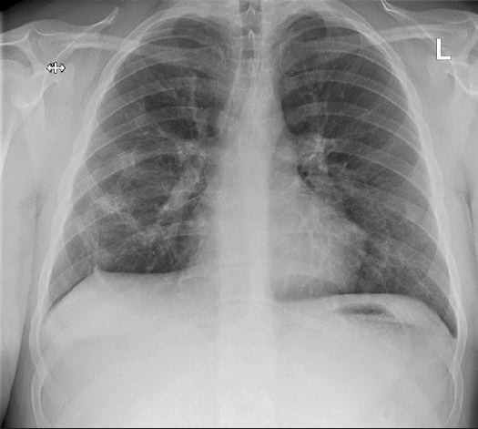
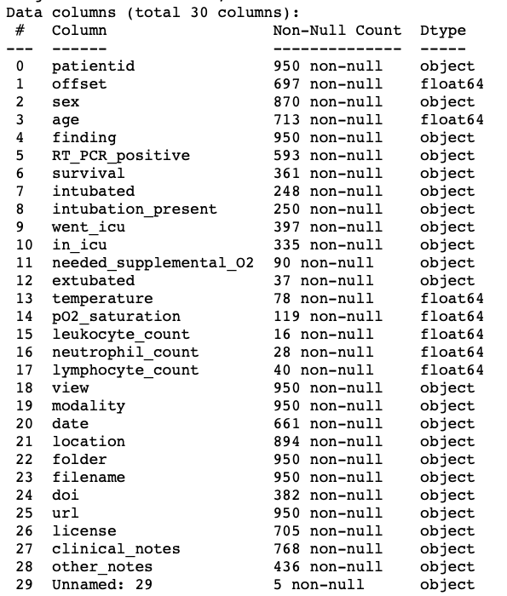
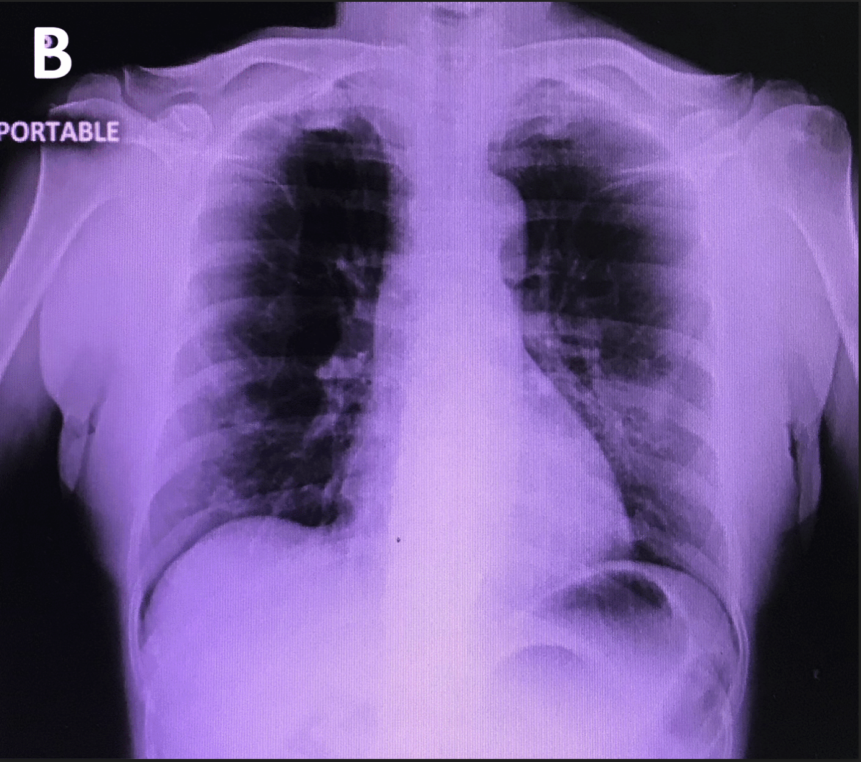
The Data
Data Source: https://github.com/ieee8023/covid-chestxray-dataset.
Notes:
Dataset has 929 images: 563 are positive and 366 are negative.

Slide 5
Data Wrangling
Dropped columns not needed.
Replaced nulls with ‘Unknown’/Avg.
Removed 21 records wit no image.
Images are considered “Positive” if “finding” column in meta data has “COVID-19”. Otherwise, “Negative”.
75/15/15 split for training/validation/test

Slide 6
Exploratory Data Analysis
Data is relatively balanced (563 positive cases and 366 negative)
Images have different sizes. So we changed all to 256x256.
As training set is small (650 images total), it is augmented by generating 11 new images per image.

Slide 7
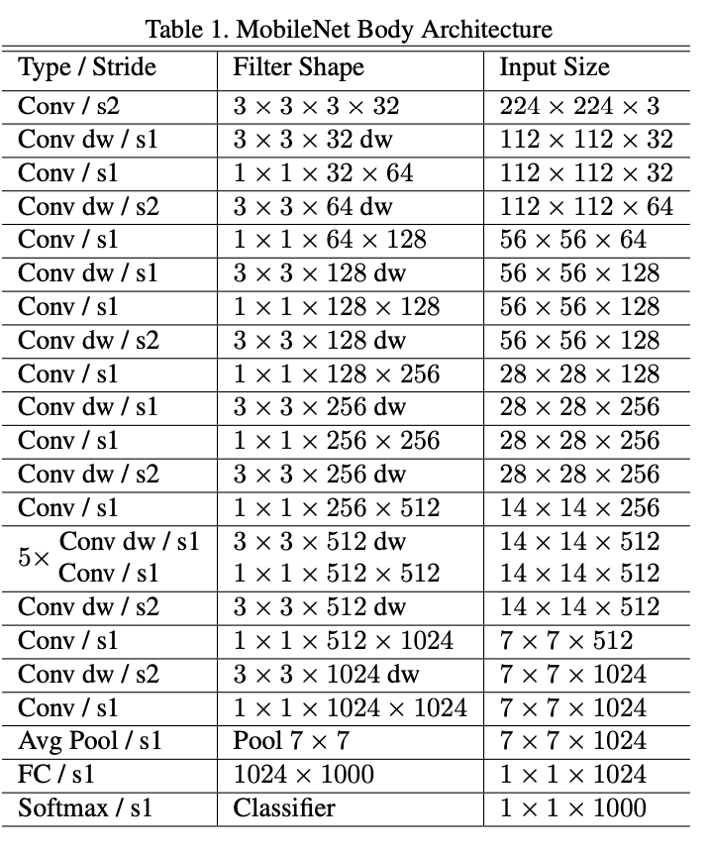
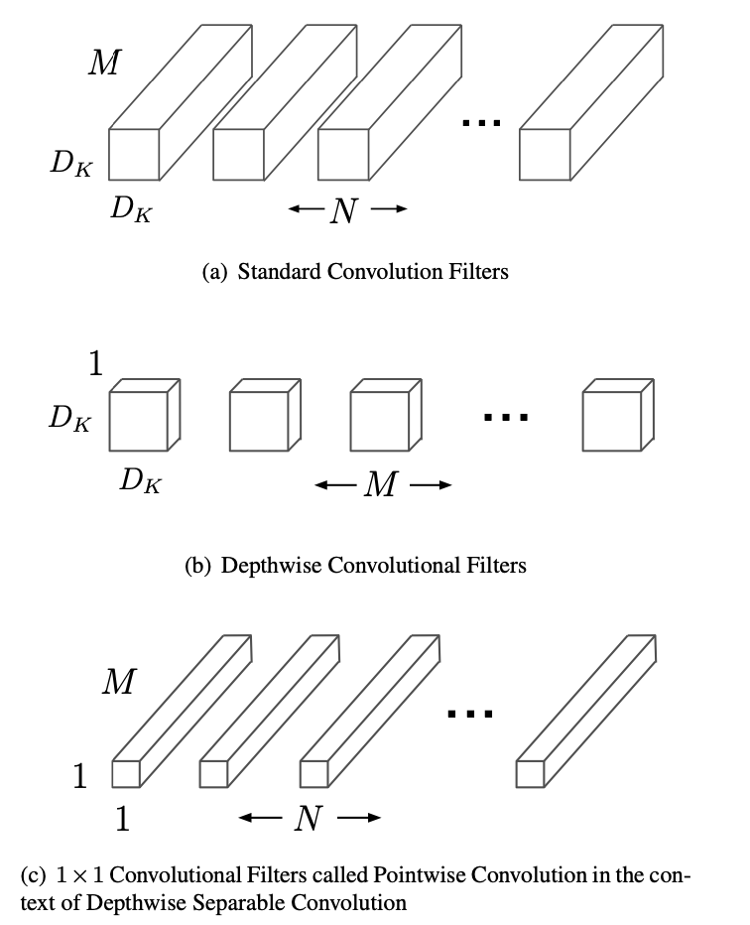
Model Selection
MobileNet is used as base model after discarding the last layer of 1000 neurons.
MobileNet has lightweight architecture. It uses depthwise separable convolutions.
Weights in the base model are pre-trained on ImageNet.

Slide 8
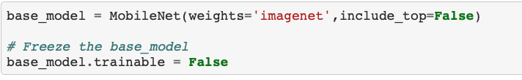
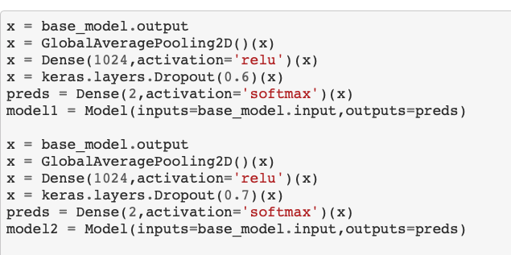
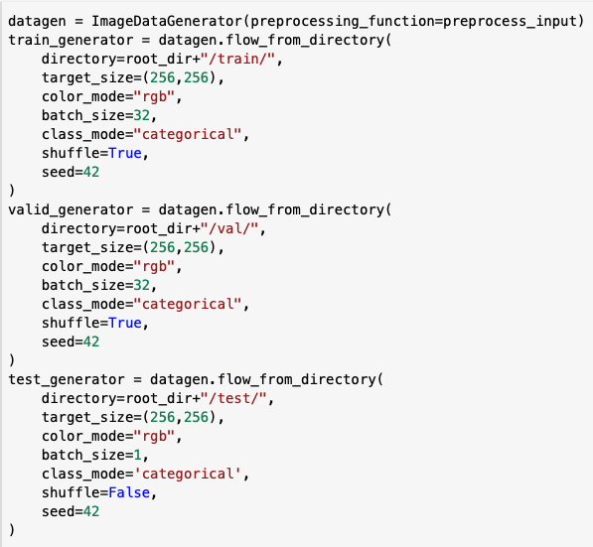
Model Selection
Base model is frozen.
2 models are considered with 1 layer added to the base model and different dropout values.
Notice that dropout values are relatively large as lower values lead to overfitting.

Slide 9
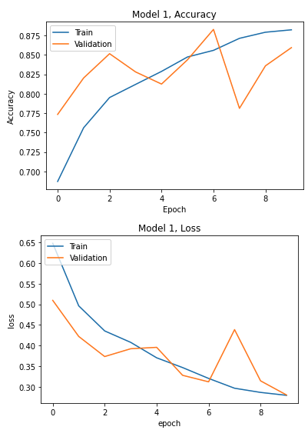
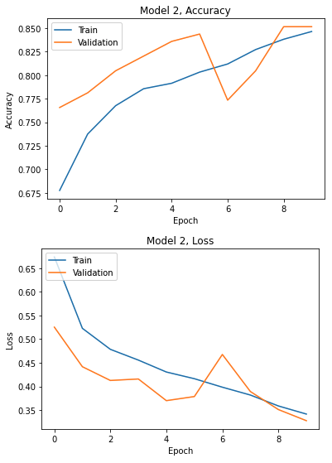
Loss and Accuracy
Based on Accuracy-Epoch and Loss-Epoch curves, we choose Model 1.

Slide 10

Performance on Test Set
Accuracy: 78 %
Confusion matrix = $\left[\begin{matrix}39 & 16 \\ 15 & 70\end{matrix}\right]$

Slide 11
Takeaways
As training set is small, augmenting images seem to be important.
To avoid overfitting, we had to use relatively large drop out values.
It seems that accuracy levels over 80% are not easy to achieve with this set of data.
Given that the ultimate goal of our model is to detect a disease, it may be better to consider precision-recall rather than accuracy.

Slide 12
Future Research
Study further optimizing the models.
Consider other metrics such as Precision, Recall and F1-score.
Investigate using additional patients’ information to further enhance models.

Slide 13
Thank You!
Kaggle and Dr. Joseph Paul Cohen (University of Montreal) for providing data
Lucas Allen for guidance during project

Slide 14
Questions?

